Slide 1
Refraction of Light through a Convex Lens Forming Real Images

Slide 2

When you have completed this lesson you should be able to:
Understand the behaviour of three principal rays drawn on ray diagrams to form a real image.
Draw ray diagrams showing the formation of a real image from a convex lens.
Describe the nature of the real image produced by a convex lens given the location of the object.

Slide 3
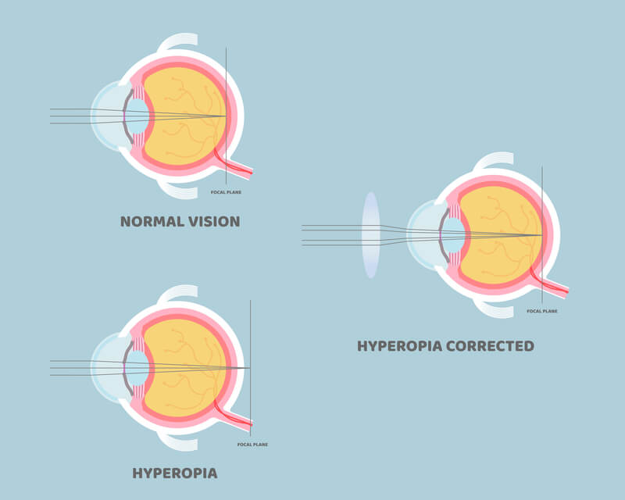
There are many uses of convex lenses in everyday life.
The most common example of lenses that we see and use on a day to day basis are the lenses placed in glasses.
If you suffer from long-sightedness or hyperopia (meaning you are unable to focus on nearby objects), then light entering your eye will focus behind your retina. This could be due to a short eyeball or an inability of the lens in your eye to focus correctly due to age. Long-sightedness is corrected by using glasses that contain convex lenses, which focus the light on your retina, resulting in sharp images being formed.

Slide 4
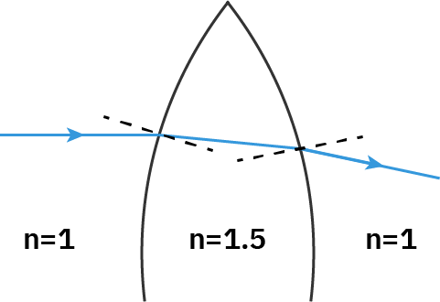
Why does light bend as it passes through a lens?
We know that light bends or refracts as it passes between two mediums that have different indices of refraction. Most lenses are made from plastic or glass which have higher indices of refraction than air.
As light enters the lens it goes into a region with a higher refractive index and therefore bends towards the normal. Similarly, as light leaves the lens it goes into a region with a lower refractive index and bends away from the normal. If we consider the light ray before it entered the lens and the light ray after it exits the lens, we can see it is travelling in a different direction and has therefore undergone refraction from the lens.

Slide 5
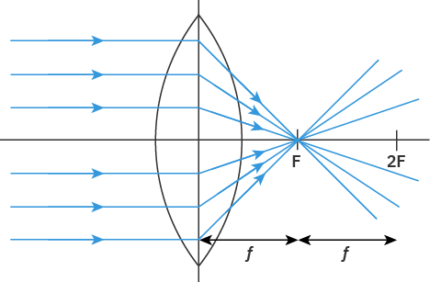
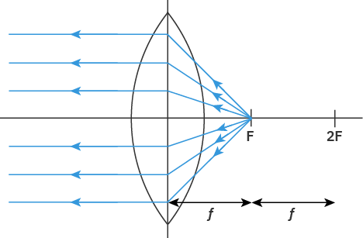
A convex lens is a type of converging lens.
This means light rays coming from a distant source (which are considered to be parallel to each other) enter the lens and get refracted inwards. These refracted rays all pass through the same spot (converge) on the other side of the lens.
The spot where all the light rays converge is called the focus of the lens, denoted by F. The distance between the focus and the lens is referred to as the focal length, f, of the lens. Twice the focus of a lens, denoted by 2F, is also included in lens diagrams. This point is located two focal lengths away from the lens.

Slide 6
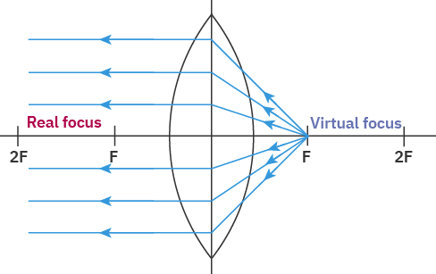
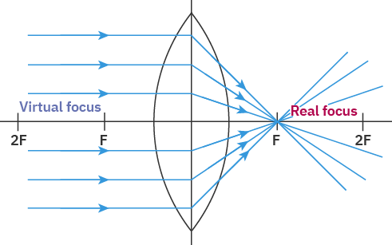
Light can pass through either side of a lens.
If light is incident on the lens from the left, then it will converge at a focus on the right. If light is incident from the right then it will converge at a focus on the left. This means every lens will have two focus points and we need to use each of these when creating ray diagrams.
To simplify this process we will label the focus which is on the same side as the incident light the virtual focus, and the focus which is on the same side as the refracted light the real focus. This choice of naming will become clear in later lessons but will help us now when trying to describe how to draw ray diagrams for lenses.

Slide 7
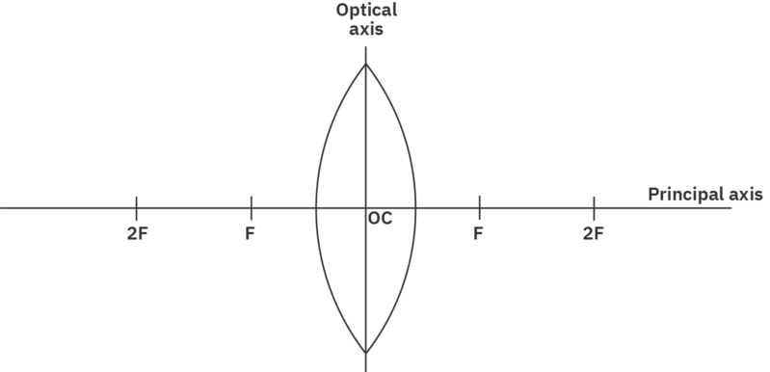
A ray diagram is a drawing which can be used to describe the image formed by a convex lens.
To draw a ray diagram we first need to draw some axes. The first of these is called the principal axis and consists of a horizontal line. The second axis is called the optical axis and it approximates the convex lens as a vertical straight line. The optical axis is placed in the middle of the principal axis and all refraction occurs along this line.
The intersection between the principal and optical axes is referred to as the optical centre of the lens, denoted in the diagram by OC. Both of the focus points and twice the distance of the focus points are also included along the principal axis. The horizontal and vertical scales of ray diagrams do not have to be the same. In fact, the vertical scale is often much more magnified than the horizontal scale, so that the diagram is easier to draw.

Slide 8
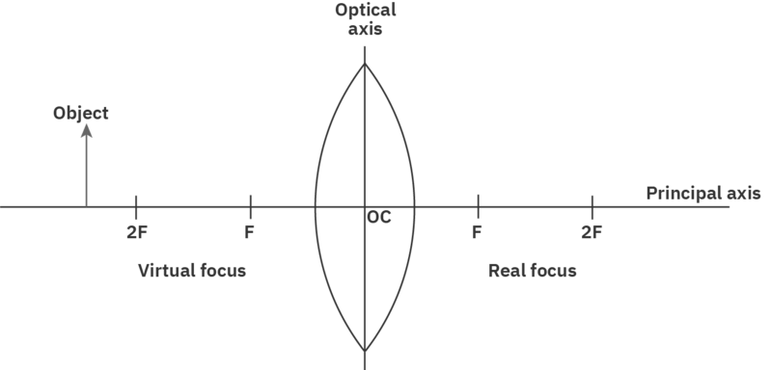
Once we have the axis of a ray diagram set up we can add the object and start to determine its refracted image.
The object is generally placed to the left of the optical axis and is represented by a vertical arrow, pointing upwards. This will make it much easier to determine the nature of the image.
The object is usually placed in relation to the properties of the lens. For our first example, we will place the object outside (to the left of) twice the virtual focus of the convex lens. Note the virtual focus is located on the same side of the lens as the object.

Slide 9
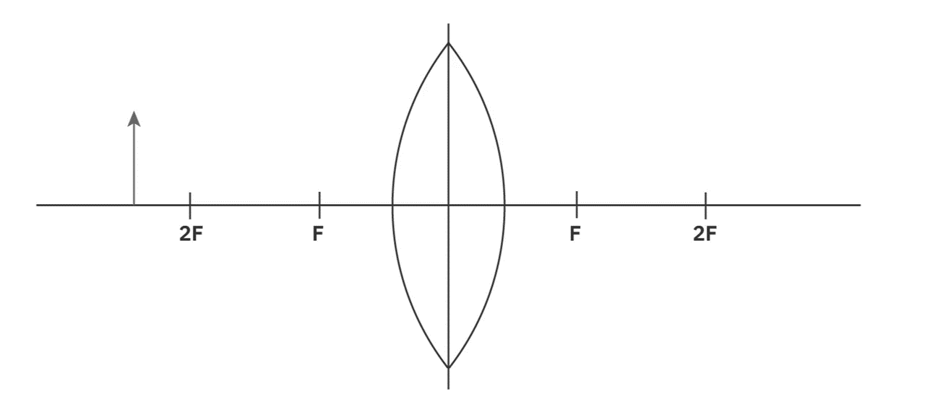
Now that we have set up our ray diagram, we can use three principal rays to determine the position of the image produced by a convex lens.
The first principal ray we consider will start at the top of the object. It will then travel parallel to the principal axis until it reaches the optical axis (the lens). As it refracts from the lens it will travel through the real focus of the lens (where all the refracted rays of incident parallel rays will converge) and continue on beyond the ray diagram.

Slide 10
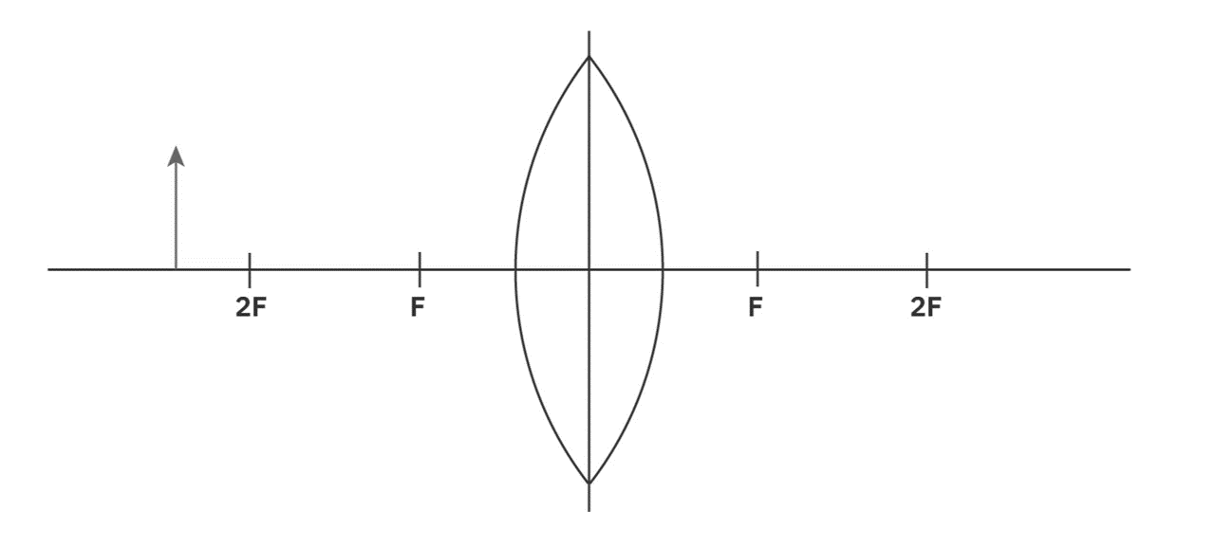
The second principal ray we will consider is the reverse process of the first principal ray.
The second principal ray will also start at the top of the object. It will then travel to the optical axis by passing through the virtual focus of the convex lens. Once it reaches the optical axis it will be refracted such that it travels parallel to the principal axis.
This rule is often shortened to: "an incident ray travelling through the virtual focus will be refracted parallel to the principal axis."

Slide 11

The third principal ray we will consider is unaffected by the lens.
The third principal ray starts at the top of the object (the same as the two previous rays). It then travels from the top of the object to the optical centre of the lens. It will pass through the optical centre of the lens along the same path, without undergoing any refraction.
Shortening this rule: "A ray will travel straight through the optical centre of the lens, unaffected by refraction."

Slide 12

To determine the location of the image we need to combine three principal rays onto one diagram.
As we draw on three principal rays (always starting from the top of the object) we notice that the three refracted rays all converge at a point below the principal axis. This point of intersection between the three refracted rays identifies the top of the image.
We can trace this location vertically back to the principal axis to show the formation of the image. Although two of the principal rays would be sufficient to determine the location of the image, we include a third principal ray just to make sure we have the correct spot.
The image in the ray diagram below is formed between the real focus and twice the real focus of the convex lens.

Slide 13
It is not enough just to show the location of the image on a ray diagram. Often we also need to describe the nature of the image, consisting of three different properties.
In the ray diagram below, we can see that the image is upside down (compared to the object). The arrow is now pointing downwards instead of upwards. We refer to this as an inverted image. If the arrow points upwards in the image it would be called an upright image.
If we placed a screen at the location of the image, we would be able to see the image on the screen. Thus, we have created a real image, formed from real light rays. If an image is not real, it is referred to as a virtual image.
It turns out that real images are always inverted and inverted images are always real. Thus, if we know one of these properties we will know the other also.

Slide 14
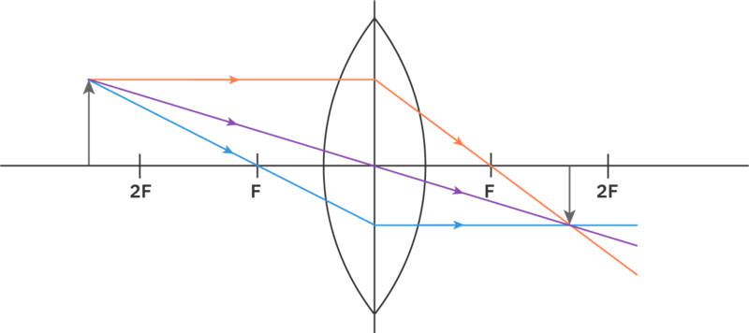
The last thing we need to consider to describe the nature of the image is its relative size.
The image in the ray diagram below is smaller than the object. We refer to this image as being diminished. If the image in the diagram had been larger than the object then we would refer to this as an enlarged image.
Thus to describe the nature of an image we must identify whether it is real or virtual, inverted or upright and enlarged or diminished. The nature of the image in the ray diagram below is real, inverted and diminished.

Slide 15
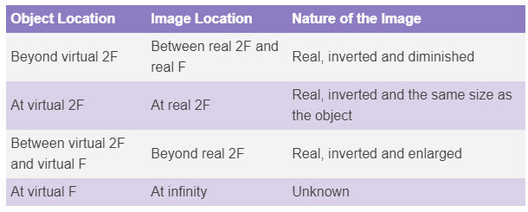
We have seen many different images formed up to this point so let's summarise all we have learned about the location of the object and the image formed.

